Slide 1
San Francisco as a Travel Destination
Farah Darwich

Slide 2
Picking a Travel destination
It can be to visit it yourself, to add it to the list pf cities your travel agency covers, or to talk about it in your tourism blog,..
It is not enough to rely on a city’s reputation or the information you have about from the media alone
There are many aspects to consider

Slide 3
San Francisco
The cultural, commercial, and financial center of Northern California
One of the most popular cities in the U.S.

Slide 4
Evaluation Metrics
This evaluation will be built on the following aspects:
Shopping Options (mainly, Shopping Malls and Shopping Plazas): Availability - Rating.
Tourist Spots (mainly, Museums, Music Venues, and Theme Parks): Availability - Rating - Affordability.
Accommodation Options (mainly, Hotels, Hostels, and Bead&Breakfast's): Availability - Rating - Affordability.
Each of those categories contain its own subcategories that will automatically be included in the analysis
Overall, 27 different categories of venues were included in this evaluation

Slide 5
Data Acquisition
I need metadata about as many possible venues in San Francisco as possible
Relying on the Foursquare API I obtained a dataset that contains metadata about 44425 venues in San Francisco
The metadata available in the dataset:
Name – categories – price – rating – number of ratings – number of likes – number of checkins – coordinates – venue URL – Foursquare URL

Slide 6
Cleaning the Data
Split the original dataset into two dataframes
1. Ratings dataframe used to evaluate ratings
Name – categories – ratings
Dropped rows with missing values
Final dataframe has 8167 rows (venues)
2. Prices dataframe used to evaluate affordability:
Name – categories – price
Dropped rows with missing values
Final dataframe has 8365 rows (venues)

Slide 7
Evaluating shopping options
Availability
34 Shopping Malls
2 Shopping Plazas
Overall, 36 available shopping options
Ratings
Average rating 7.74

Slide 8
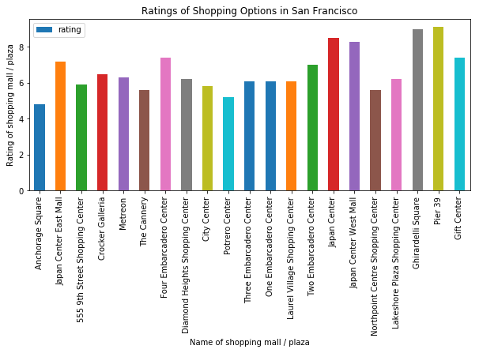
Evaluating shopping options - ratings

Slide 9
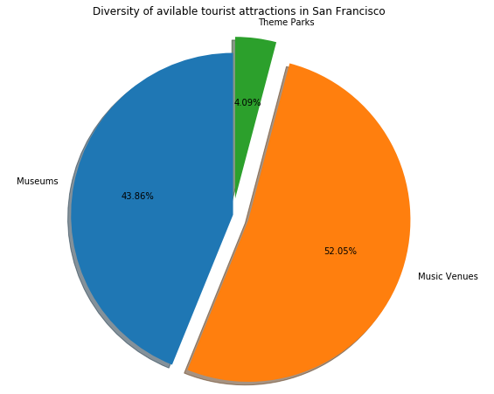
Evaluating Tourist Spots - Availability
Availability
150 Museums
178 Music Venues
14 Theme Parks

Slide 10
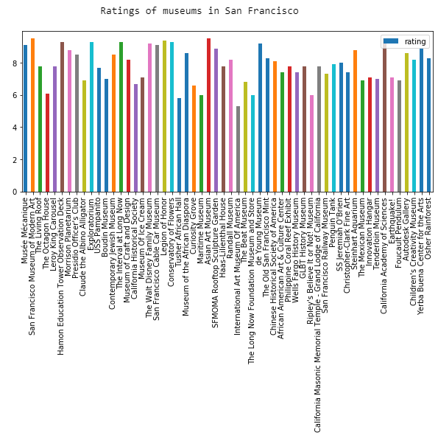
Evaluating Tourist Spots - Ratings
Ratings
Average rating 7.91

Slide 11
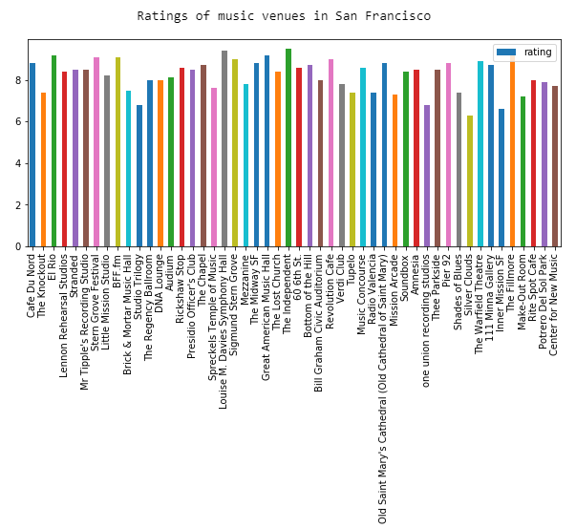
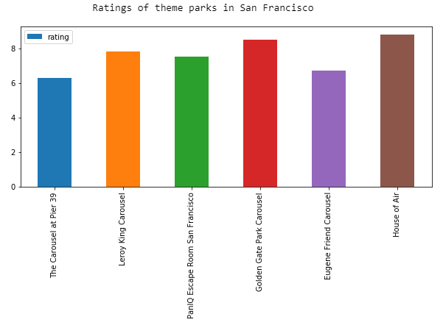
Evaluating Tourist Spots - Ratings

Slide 12
Evaluating Tourist Spots - Affordability
Prices
Museums {2 - 2}
Music Venues {1 – 2}

Slide 13
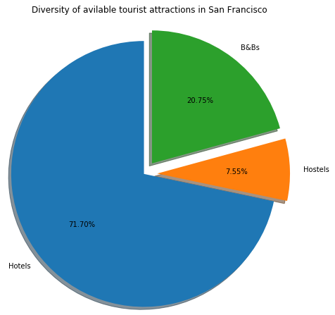
Evaluating Accommodation Options - Availability
Availability
418 Hotels
44 Hostels
121 Bed and Breakfasts
Overall, 583 available accommodation options

Slide 14
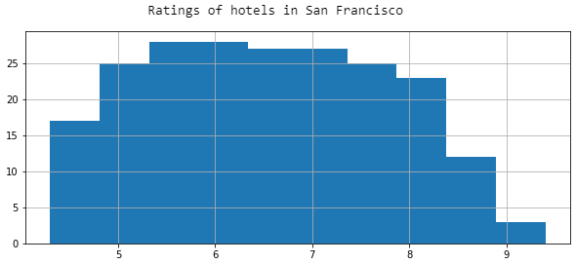
Evaluating Accommodation Options - Ratings
Ratings
Average rating 6.67

Slide 15
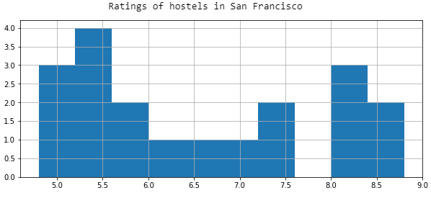
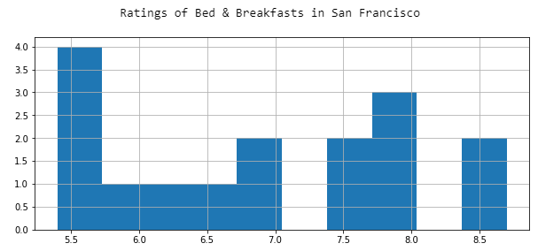
Evaluating Accommodation Options - Ratings

Slide 16
Evaluating Accommodation Options - Affordability
Prices
Hotels {1 – 3}
Hostels {3 – 3}

Slide 17
Final Assessment
Shopping Options
The city of San Francisco has a less than impressive number of shopping options (malls and plazas) available
It makes up for it with a respectable average rating of 7.74
None of their ratings goes below 5, and most of them are between 7 and 9

Slide 18
Final Assessment
Tourist Spots
When it comes to tourist spots, San Francisco is at an abundance
There is a relatively high diversity of tourist attractions available, with a noticeably lower number of theme parks compared to museums and music venues
Most of the museums scored between 6 and 9 and none of them went below 5
Music venues showed better results as most of them scored between 7 and 9 and none of them went below 6.5
Same goes for theme parks which scored between 6 and 9.
What was really note-worthy is how affordable the tourist spots turned out to be, especially compared to their relatively high ratings; both museums and music venues don’t go above 2 (on a scale of 1 to 4, 4 being the most pricey)

Slide 19
Final Assessment
Accommodation Options
There is a high number of options available, with a decent diversity
Most hotel ratings are between 5 and 8 and some of them went below 5
The most common ratings for hostels were 5~6 and 8~9, with the rest in between
Same thing for B&Bs
Hotel prices ranged between 1 and 3 (understandably, considering the wide range of ratings they have),
hostels scored an even 3
There were no information available on B&B prices

Slide 20
Conclusion and Future Direction
I evaluated three main aspects: Shopping options based on their availability and ratings, tourist spots based on their availability, ratings and prices, an accommodation options based on their availability, ratings, and prices as well
Overall, San Francisco performed relatively well on all of these aspects
It has a respectable number of highly-rated shopping options
an abundance of highly rated and very affordable tourist attractions
a large collection of accommodation options with a wide range of ratings and prices to suit everyone
More evaluation metrics can be added to this analysis to get a broader assessment of San Francisco as a travel destination, and these metrics should be chosen based on the stakeholders’ main objectives.

